Slide 1
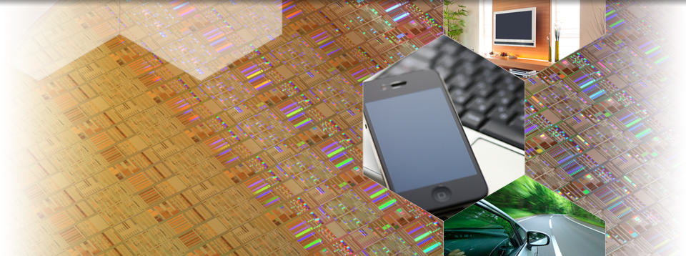
TOK’s microprocessing technology that creates inspiration

